Slide 1

Checking the eFA500 NUC121 Firmware Version

Slide 2
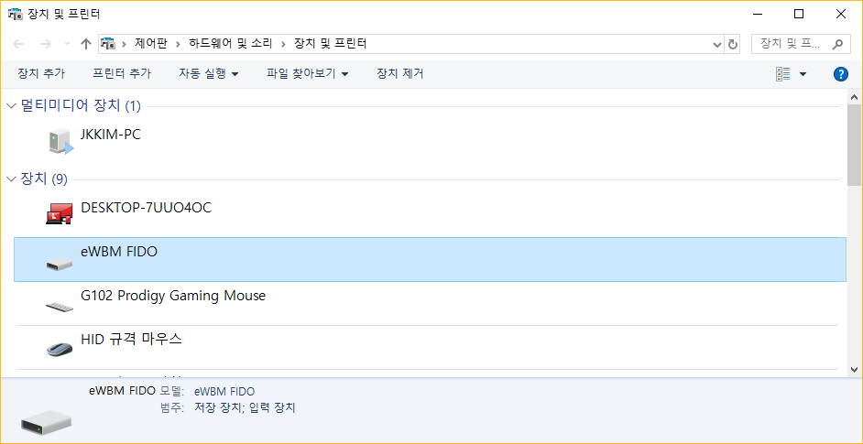
1. Open the “Devices and Printers”
2. Double Click the “eWBM FIDO”

Slide 3
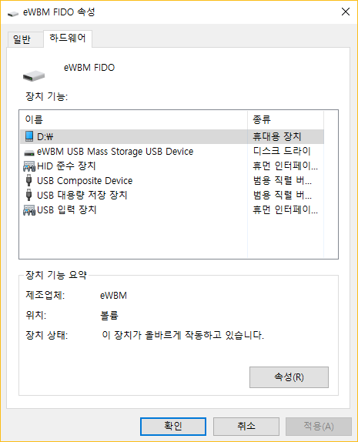
3. Click the “Hardware” tab
4. DoubleClick this(D:\) =>
(This name may be another alphabet, such as E, F, G, H.)

Slide 4
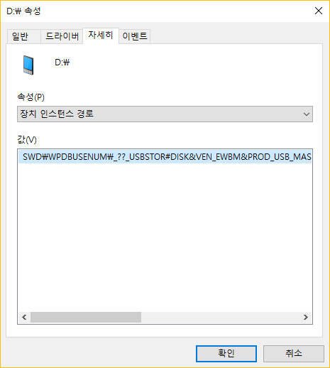
5. Click the “Detail” tab
6. Select the “Device instance path”
Old Firmware
SWD\WPDBUSENUM\_??_USBSTOR#DISK&VEN_EWBM&PROD_USB_MASS_STORAGE&REV_0.01#7&23B1A7C1&0&A00018:00:39&0#{53F56307-B6BF-11D0-94F2-00A0C91EFB8B}
New Firmware
SWD\WPDBUSENUM\_??_USBSTOR#DISK&VEN_EWBM&PROD_USB_MASS_STORAGE&REV_0.01#7&386F0A2C&0&A00015:39:37&0#{53F56307-B6BF-11D0-94F2-00A0C91EFB8B}
7. Check the Value

